Slide 1
Operating system Fundamentals
Ch 08 Scripts part 1

Slide 2
Contents
recap
simple scripts
variables
back quotes
arguments
log files

Slide 3
Recap

Slide 4
Linux command
Every command is a programme
Every command has two inputs
  standard input (System.in)
  command-line parameters (and options) (args)
Every command has three outputs
  standard output (System.out)
  standard error (System.err)
  exit code (System.exit())

Slide 5
Example in Java
public static void main(String[] args) {
if (args.length != 0) {
System.err.println("Error! Do not provide parameters\n");
System.exit(1);
}
String s;
s = new Scanner(System.in).nextLine();
System.out.printf("You entered the string '%s'\n", s);
}

Slide 6
Example in C
#include <stdio.h>
int main(int argc, char** argv) {
if (argc != 1) {
fprintf(stderr, "Error! Do not provide parameters\n");
return 1;
}
char s[100];
scanf("%s", s);
printf("You entered the string '%s'\n", s);
return 0;
}

Slide 7
Unix command
parameters (arguments)
bash
exit code
bash
executable
stdin
stdout
console
console
stderr

Slide 8
echo "bla" >test
"bla"
exit code
bash
bash
echo
stdin
(empty)
"bla"
test
console
console
stderr

Slide 9
cat file | grep -E "bla" 2>/dev/null
"bla"
exit codes
bash
bash
cat
grep
stdin
file
stdout
console
/dev/null
stderr
Notes:
${PIPESTATUS[0], ${PIPESTATUS[1]

Slide 10
Simple scripts

Slide 11

Simple scripts

Slide 12
Simple scripts
A script is a text file.
A script can be written in different languages
(Bash, R, Python, PHP, Perl, etc.)
→ we write in bash
simplest script = list of commands
useful for bundling commands and executing them regularly (automation)

Slide 13
Example: backup
Suppose: you want to take regular backups
Commands:
tar zcf /tmp/backup.tgz /root 2>/dev/null
sync
problems:
  lots of typing
  risk of typing errors

Slide 14
Solution: create a script
Create a text file "~/bin/backup1" containing:
echo "Backing up..."
tar zcf /tmp/backup.tgz /root 2>/dev/null
sync
echo "Done."
Make it executable with:
chmod +x ~/bin/backup1

Slide 15
Shebang
When executing, bash will interpret the lines
What if you call the script from another shell?
What if the script is written in a different shell/language?

Slide 16
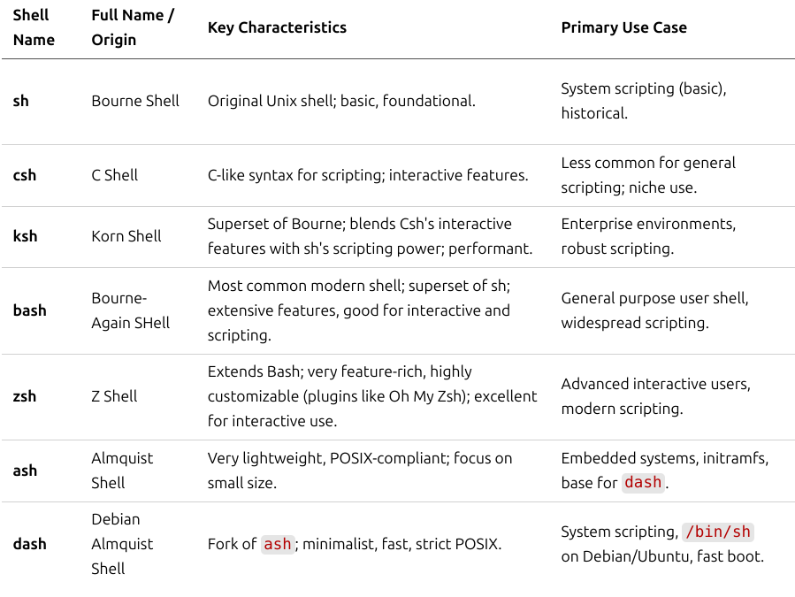

Slide 17
Shebang
Solution:
#!/bin/bash
echo "Backing up..."
tar zcf /tmp/backup.tgz /root 2>/dev/null
sync
echo "Done."
Other options:
  /bin/sh, /usr/bin/perl, /usr/bin/python3, …
  example: #!/usr/local/bin/python3
  example: #!/usr/bin/env bash

Slide 18
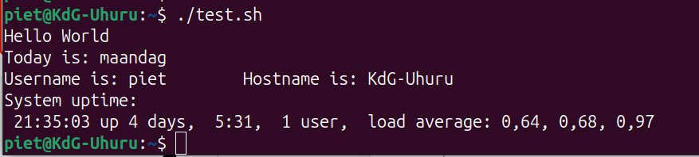
Exercise
Create a new text file called hello.sh with the following content:
#!/bin/bash
echo "Hello world"
Make the file executable:
chmod +x hello.sh
Run the file:
./hello.sh
Extend the script: Print today's date, your username, hostname the uptime of the system

Slide 19
#!/bin/bash
echo "Hello World"
echo -n "Today is: "
#This is a comment: Run the date command
date +%A
echo -e "Username is: $USER\t Hostname is: $HOSTNAME"
echo "System uptime:"
# Run the uptime command
uptime

Slide 20
Variables

Slide 21
Variables
What if we want to back up to a different directory?
What if we want a different file name for the tar file?
What if we want to back up other files?
...

Slide 22
Variables
Start with letter (or _)
Avoid hyphens (-)
Lowercase with Underscores for Local Variables
Uppercase for Constants and Environment Variables
No CamelCase
Descriptive: not dir but backup_dir
#!/bin/bash
backup_dir=/tmp
backup_file=backup.tgz
files=/root
echo "Backing up to $backup_file..."
tar -zcf "${backup_dir}/${backup_file}" ${files} 2>/dev/null
sync
echo "Done."

Slide 23
Variables – use {}
{} explicitly marks variable boundaries so text can follow immediately.
${var}
$ var=Good
$ echo $varbye
bye
$ echo ${var}bye
Goodbye
Notes:
Here string: echo "aaa" | tr "a" "A" → tr "a" "A" <<< "aaa"

Slide 24
Variables – use "${var}"
$ mkdir "My Documents"
$ var="My Documents"
$ ls ${var}
ls: cannot access 'My': No such file or directory
ls: cannot access 'Documents': No such file or directory
$ ls "${var}"
$ touch "${var}/document"
$ ls "${var}"
document
$
Notes:
Here string: echo "aaa" | tr "a" "A" → tr "a" "A" <<< "aaa"

Slide 25
Variables – use "${var}"
$ var="*.txt"
$ echo ${var}
*.txt
$ touch doc.txt
$ echo ${var}
doc.txt
$ echo "${var}"
*.txt
$ ls "${var}"
ls: cannot access '*.txt': No such file or directory
Notes:
Here string: echo "aaa" | tr "a" "A" → tr "a" "A" <<< "aaa"

Slide 26
Variables scope – use export
Create a script: var.sh
#!/bin/bash
echo ${var}
Execute the commands:
$ var=Hello
$ ./var.sh
→ no output
$ echo $var
Hello
$ export var
$ ./var.sh
Hello

Slide 27
Variables scope – use export
If you want to change variables outside the script
(such as environment variables):
export PATH=${PATH}:/home/jan/bin

Slide 28
"read only" Variables
Create readonly variables
(like "final" in Java)
$ readonly backup_dir="/root"
$ echo $backup_dir
/root
$ backup_dir="/etc"
-bash: backup_dir: readonly variable

Slide 29
Numeric variables - integers
Variables do not need to be declared: they are always of type String.
You can put a number in a variable, but it will then be a String
If you want to perform calculations with these numbers, use the following syntax (only works with integers!):
var=1
echo $((var+1))
var=$((var+4))
Notes:
Here string: echo "aaa" | tr "a" "A" → tr "a" "A" <<< "aaa"

Slide 30
Numeric variables – decimal numbers
Install bc → sudo dnf install bc
bash calculator
bc accepts a string as input
eg. echo "3.14 * 2* 3.0" | bc –l
If you want to calculate with variables:
pi=3.14
rad=3
echo "$pi * 2 * $rad" | bc –l
echo $(echo "$pi * 2 * $rad" | bc -l)
circ=$(echo "$pi * 2 * $rad" | bc -l)
printf "%.2f\n" "$circ"
Notes:
Here string: echo "aaa" | tr "a" "A" → tr "a" "A" <<< "aaa"

Slide 31
Input questions
#!/bin/bash
readonly backup_dir=/temporary
readonly files=/root
echo -n "enter backup filename ->"
read -r backup_file
echo "Backing up to ${backup_file}..."
tar -zcf "${backup_dir}/${backup_file}" ${files} 2>/dev/null
sync
echo "Done."

Slide 32
read
read is a bash "built-in", not a separate programme.
There is no man page, but you can request help via:
help read
help –r → do not allow backslashes
help –s → do not echo input coming from a terminal
help –rs → use this for passwords

Slide 33
Exercise
Create a script that asks the user for two numbers
and returns the sum
Example ouput:
Enter a number: 37
Enter a number: 5
The sum of 37 and 5 is 42

Slide 34
Default values
${word} displays the content of "word", but what if it does not exist?
${word:-hello}
  displays the content of the variable "word"
  if "word" does not exist (or is empty), this returns the word "hello"
  does not change the value of "word"!

Slide 35
Default values
is used if backup_file does not exist or is empty;
the variable remains empty
#!/bin/bash
backup_dir=/temporary
files=/root
echo -n "enter backup filename (backup.tgz) ->"
read -r backup_file
echo "Backing up to ${backup_file:-backup.tgz}..."
tar -zcf "$backup_dir/${backup_file:-backup.tgz}" ${files} 2>/dev/null
sync
echo "Done."

Slide 36
Default values
${word} displays the content of "word", but what if it does not exist?
${word:=hello}
  returns the content of the variable "word"
  if "word" does not exist (or is empty), this returns the word "hello" and the variable also gets this value

Slide 37
Default values
is used if backup_file does not exist or is empty;
the variable is now also changed
#!/bin/bash
backup_dir=/temporary
files=/root
echo -n "enter backup filename (backup.tgz) ->"
read -r backup_file
echo "Backing up to ${backup_file:=backup.tgz}..."
tar -zcf "${backup_dir}/${backup_file}" ${files} 2>/dev/null
sync
echo "Done."

Slide 38
Checking variables
You can also check whether a variable has a value ${word:?variable does not exist!}
  continues if "word" already has a value
  gives an error message if "word" has no value
  and stops the script
example:
  cd ${JAVA_HOME:?"error JAVA_HOME is empty"}
  param1=${1:?Parameter missing}

Slide 39
Quotes

Slide 40
Quotes
There are three types of quotations
  'single': take the text between them literally
  'double': replace any variables with their value
  back quotes: execute the command within the quotes and replace the variable with the standard output command
  legacy

Slide 41
Back quotes
hello=”hola”
echo "date ${hello}"
echo "date \${hello}"
echo 'date ${hello}'
echo `date` ${hello}
The use of backquotes for command execution is legacy.
It is not very readable and prone to errors.
Use command substitution instead
`date`
$(date)

Slide 42
cat $(ls *.java) | grep -E "$bla"
bash
"*.java"
-E contents of $bla
exit codes
bash
ls
names java files
cat
grep
stdout
Java
files
console
stderr
Notes:
${PIPESTATUS[0], ${PIPESTATUS[1]

Slide 43
Backup script
#!/bin/bash
#today=`date +%Y%m%d` → legacy notation
today=$(date +%Y%m%d)
backup_dir=/temporary
backup_file=backup${today}.tgz
files=/root
echo "Backing up to $backup_file..."
tar -zcf "${backup_dir}/${backup_file}" ${files} 2>/dev/null
sync
echo "Done."

Slide 44
Arguments

Slide 45
Arguments
Every command in Unix can receive command-line parameters (arguments) as input.
a script can also use these
  Parameters are separated by spaces in scripts:
    $0 = name of the script
    $1, $2, ..., $9 = first to ninth parameter
    $# = number of parameters
    $* = all parameters as 1 string

Slide 46
Example
#!/bin/bash
echo "number of parameters: $#"
echo "all parameters as 1 string: $*"
echo "command = $0"
echo "parameter 1 = $1"
echo "parameter 2 = $2"
echo "parameter 11 = ${11}"
echo "parameter 11 = ${12?Parameter not submitted}"

Slide 47
Backup script
#!/bin/bash
today=$(date +%Y%m%d)
backup_dir=/temporary
backup_file=backup$today.tgz
files="/root"
echo "Backing up to $backup_file..."
tar -zcf "${backup_dir}/${backup_file}" ${files} "$*" \
2>/dev/null
sync
echo "Done."

Slide 48
Log files

Slide 49
Scripts often create log files
#!/bin/bash
today=$(date +%Y%m%d)
backup_dir=/temporary
backup_file=backup${today}.tgz
files="/root $@"
logfile=/var/log/backup.log
echo "Backing up to $backup_file..."
tar -zcf "${backup_dir}/${backup_file}" ${files} 2>>${logfile}
sync
echo "${today}: backup successful" >>${logfile}
echo "Done."

Slide 50
Conclusion
A script is like a Java programme:
  echo -> System.out.println()
  read -> keyboard.nextLine()
  variables -> always type String
  use $((...)) or bc to calculate
  exit -> System.exit()
  $1, $2, ... -> args
  if, for, while, switch -> next lesson
  functions (methods) -> next lesson

Slide 51
Exercises

Slide 52
Exercises
Canvas → chapter 7
7.1 Write a bash script named multiply.sh.
The script accepts 2 arguments.
Print the product of the 2 arguments to STDOUT. (echo)
7.2 Write a script loggedin.sh that displays a sorted list of all logged-in usernames.
7.3 Create a script countfiles.sh that counts how many directories and files are in the current user's home directory. Store that count in the variable "filecount". Print to the screen: "The home dir contains <filecount> files."
7.4 Write a script hello.sh that expects a name as a parameter. The script saves this name in a variable name. If no parameter was provided, the script stops with an error message. If a parameter was provided, the script says <date>: Hello, <name> where the date and name are filled in.
7.5 Write a script searchwords.sh that asks the user for 2 words. The script searches for these words in the file "text.txt" (create this beforehand) and displays every line where one of these words occurs. If a word is empty, it is replaced by "blahblah" and searched for that instead.
7.6 Create a script lockUser.sh that you can use if a user has misbehaved. The script expects 1 parameter: the username. The script locks the user (using the sudo passwd command). Then, it creates a tar archive of that user's home directory. The tar archive is placed in the /root/blockedUsers folder. After that, the user's home folder is removed.

